Slide 1
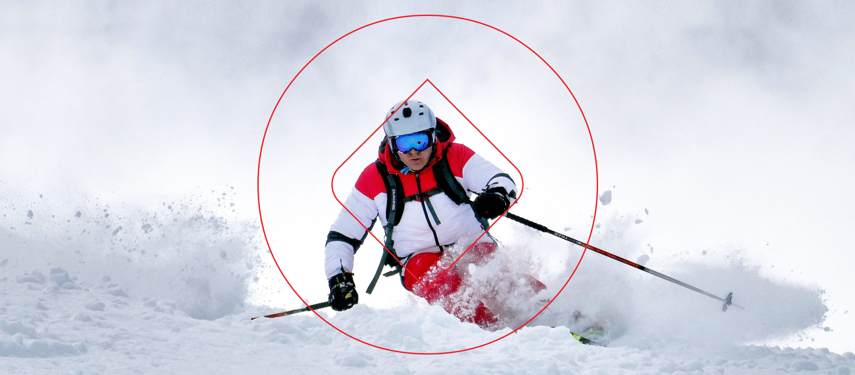
Legal & Human Rights CONSIDERATIONS Around Establishing Proof of Vaccination Requirements as a Condition of Sport Participation OR club ACCESS
Presentation by: Steven Indig, LL.B.

Slide 2
WHO WE ARE: SPORT LAW
Providing strategic insight to the Canadian sport community through professional services in these areas:
Legal Solutions
Communications
Human Resource Management
Governance
Risk Management
Financial Management
Safe Sport
Equity, Diversity, and Inclusion

Slide 3
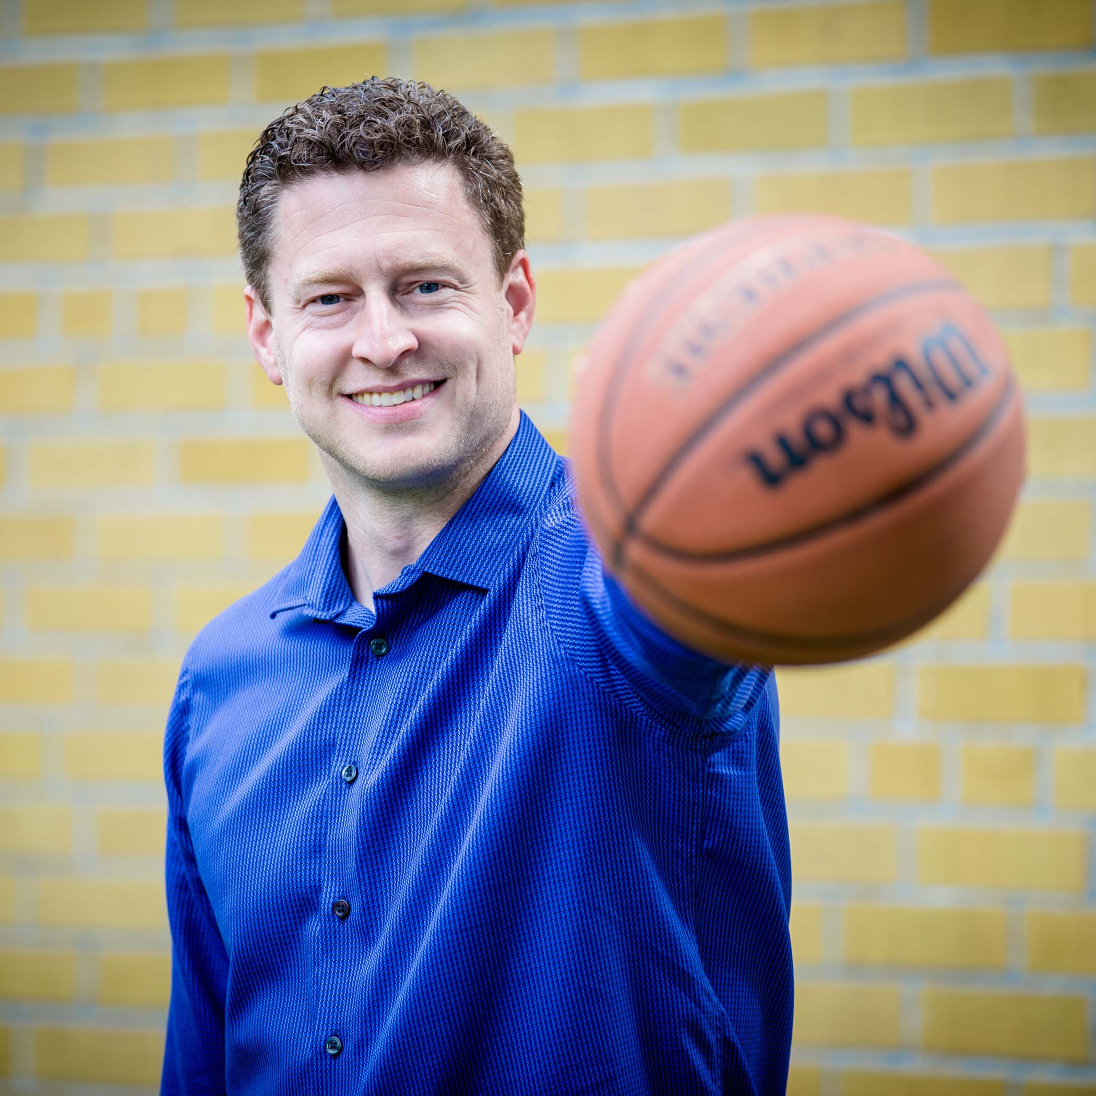
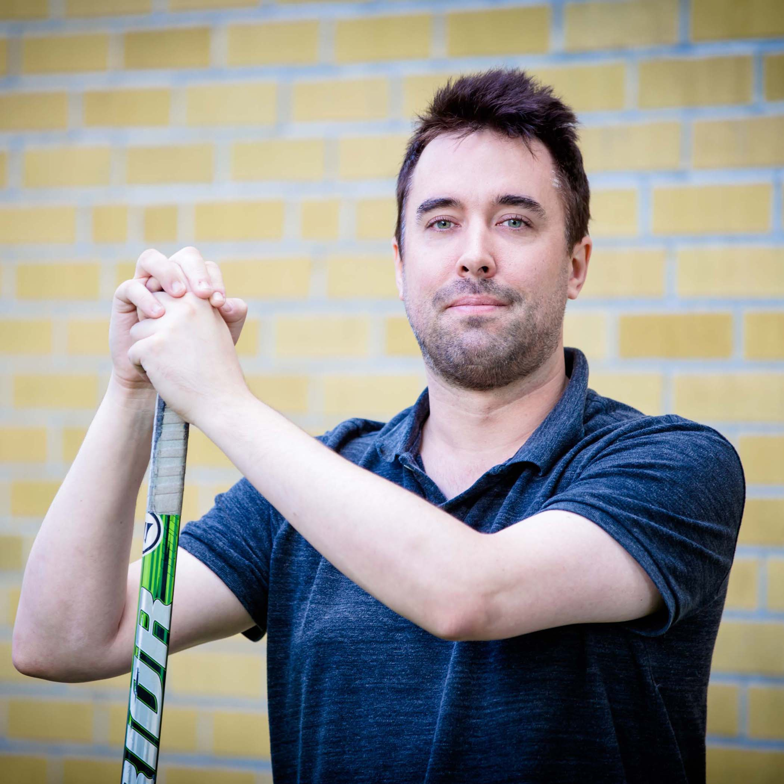
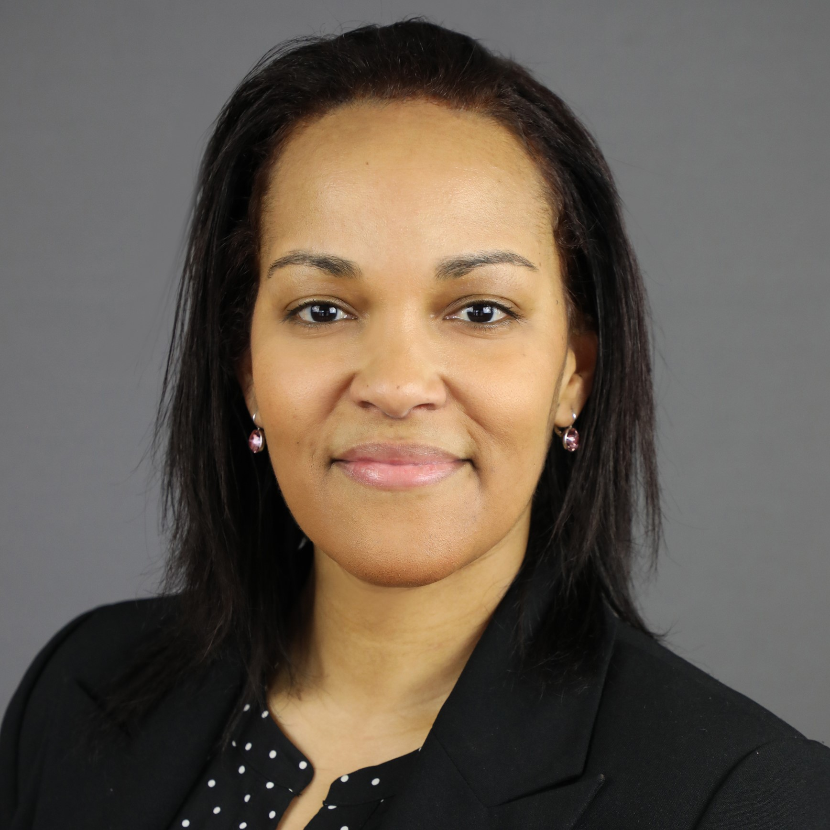
SPORT LAW
Our Team

Slide 4
Agenda
Vaccination Trends
Understanding the Law
Human Rights
Health Information
Mandating Vaccinations

Slide 5
Vaccination Trends
Federal government unlikely to provide guidance on vaccination passports
Manitoba announced it would provide immunization cards to residents who have been fully vaccinated, allowing them to travel domestically without being required to self-isolate when they return.
Western University announced it would require students living in residence to show proof of immunization.
Quebec began issuing downloadable QR code as proof of vaccination to limit people’s access to non-essential service (bars, gyms, contact sports) if Covid worsens. (Possible implementation of September 1)
Saskatchewan announced it would not require proof of vaccination for resident looking to return to work or attend events (a violation of the Health Information Protection Act)

Slide 6
Vaccination Trends
Canada’s federal, provincial and privacy commissioners issued a joint statement warning that vaccine passports “may offer substantial public benefit, it is an encroachment on civil liberties that should be taken only after careful consideration.”

Slide 7
Human Rights

Slide 8
DISCRIMINATION
Definition:
To make a distinction.
Recognition of differences.
Prejudicial treatment of a person or a group of people based on certain characteristics.

Slide 9
CANADIAN CHARTER OF RIGHTS AND FREEDOMS
Section 15(1):
Every individual is equal before and under the law and has the right to the equal protection and benefit of the law without discrimination…

Slide 10
THE CHARTER - JURISDICTION
Applies to matter of “government action”
Corporation mandated by government statute
Public School Sport
Municipal Sport and Recreation Programs
Private schools, Private club and other privately owned businesses are not part of “government action” and thus are not subject to the Charter

Slide 11
It is a discriminatory practice in the provisions of goods, services, facilities or accommodation customarily available to the general public (Section 1 of OHRC):
PROVINCIAL HUMAN RIGHTS LEGISLATION
(a) to deny, or deny access to, any goods, service, facility, or accommodation to any individual, or
(b) to differentiate adversely in relation to any individual, on a prohibited ground of discrimination.
An organization offering services or access to program and facilities to the “public” comes under the jurisdiction of the human rights law of that jurisdiction.

Slide 12
PROHIBITED GROUNDS
Section 1 - Every person has a right to equal treatment with respect to services, goods and facilities, without discrimination because of:
Race Ancestry
Place of origin Color
Ethnic origin Citizenship
Creed Sex
Sexual orientation Age
Gender Identity Gender Expression
Marital Status Family Status
Disability

Slide 13
LEGAL ANALYSIS
Is there differential treatment (discrimination)?
Is the discrimination based on a prohibited ground?
Is there justification?
must be supported by more than impressionistic evidence, expert evidence is often needed.
must be supported by substantial and bona fide evidence that such an exception is reasonable and necessary under the circumstances.
Is reasonable accommodation possible?

Slide 14
JUSTIFICATION
Decency (Public Morals – which change over time)
Prohibiting boys and girls in the same change room
Boys and girls wrestling (prohibited but now accepted)
Affirmative Action
Special Programs intended to prevent or break historic or systemic patterns that have worked to disadvantage groups or people (considered to be opportunities not disadvantaging a group)
OWHA (1986) deemed they needed to exclude men from its programs in order to survive.
Safety is generally accepted reasonable justifications.
Party seeking to justify discriminatory practice must prove, with evidence, that the justification is reasonable.
Scientific evidence usually required and difficult to ascertain

Slide 15
REASONABLE ACCOMMODATION
It is necessary to make reasonable accommodations for the particular needs of an individual or group if those needs are based on a prohibited ground to the point of undue hardship.
Some flexibility in how a rule, policy or procedure is applied may be possible and appropriate.

Slide 16
Legal Obligations
Organizations owe a duty to their staff and stakeholders to maintain a safe and healthy environment, including an outbreak of an infectious disease.
An Organization is required, “take every precaution reasonable in the circumstances for the protection of a stakeholder”, there is currently no legislation that specifically addresses the steps Organizations must take to meet this duty in the context of the COVID-19 pandemic.
What might be considered “reasonable” will depend on the environment and circumstances.
The available case law on mandatory workplace vaccinations, or “Vaccinate or Mask” policies largely revolves around unionized workplaces in the long-term care, retirement home, and other health-care sectors. The outcome of such decisions have not been entirely consistent; however, Canadian courts have upheld both vaccine and mask mandates.

Slide 17
Covid Considerations
The Risk to Health & Safety
The existence of COVID-19 variants may spread more rapidly than the original strain of the virus and may impact people more severely;
COVID-19 is transmissible by asymptomatic individuals, it may go undetected, thus the more rapid spread of COVID-19 variants can lead to more cases, and potentially more deaths;
The potential risk of COVID-19 spread is highest when individuals are indoors, within two metres of each other, in a small space with limited ventilation, sharing equipment or food, and/or taking deep breaths (e.g. while shouting or exercising). Therefore, recreational activities and sports occurring indoors and/or in close proximity to others, are considered higher risk;
Maintaining physical distance during recreation activities and sport can often be more challenging, especially when the activities involve younger children, who may not fully understand the risk; and
Some sports and athletic activities, especially those that are high-contact or team sports, can pose a greater risk for COVID-19 transmission.

Slide 18
Human Rights Considerations
An individual’s reasons for refusing to get vaccinated do not relate to a valid human rights ground (religion or health reasons), based on a political or strongly held personal belief for example, this would be insufficient to claim discrimination.
To argue that mandatory vaccination is a bona fide, a court might ask,
What are the potential harms from COVID-19?
What is the evidence of the effectiveness of vaccines in responding to those harms? For example, if the objective is to prevent transmission, what is the efficacy of the current available vaccines for preventing all (and newer) strains of the virus?
Is there evidence that mandatory vaccination is more effective than alternative health and safety measures (such as mask wearing and regular testing) that could be implemented?
Are there practical considerations (e.g., cost, access to vaccines, enforcement difficulties) that make the vaccine, or other alternative measures, an unreasonable or ineffective measure?
Would, or could, a more lenient policy, such as strongly encouraging vaccination achieve the same objective?
Even if mandatory vaccination is held to be bona fide, it would still have to be shown that it would be an undue hardship to make an accommodation for an unvaccinated individual, taking into account all the circumstances, including health, safety, magnitude of risk, bearers of risk, cost, etc.

Slide 19
Privacy Concerns

Slide 20
Privacy Concerns
An underlying assumption involving the use of vaccination passports is that individuals are required to disclose personal health information to access programming or be granted access to a facility. While there are potential benefits to these documents, there are significant legal issues to consider.
The use of vaccination passports has the potential to encroach on the rights of participants, including substantial privacy concerns around the collecting and storage of personal health information. This type of information is highly confidential and tightly regulated by provincial and federal legislation.
Other concerns include potentially discriminating against individuals who may have valid reasons for not being vaccinated or who may be unable to receive a vaccination, including pre-existing medical conditions or religious beliefs. Requiring individuals to prove that they are fully vaccinated may expose an organization legal liability, including the possibility of human rights complaints.
Privacy legislation prohibits a business from requiring an individual to consent to their personal information as a condition of services, unless doing so is “necessary” to safely provide the service (and there is no equally effective and less privacy-intrusive measures available)
If an organization does want to consider requiring proof of vaccination, it is critical to develop a clear protocol for freely obtaining the consent of individual participants and securing this confidential information, both with respect to who has access to this information and retention of these records.

Slide 21
The Big Question
Can we ask our members to confirm their vaccination status?
Short answer is yes, but only if the applicable human rights and privacy obligations are considered.
Alternative option is to indicate all required Covid related protocols, but if the person voluntarily provides their vaccination status, those requirements can be minimized.
Clubs should carefully consider options for members protected by human rights so they can be provided services in other ways.
If collecting vaccination status, it would be prudent to provide members notice and explain the purpose for which the information is being collected.
Health and safety purposes” may not be sufficient if other measures that do not require the collection of personal information could be just as effective (physical distancing, masks, etc.)

Slide 22
Best Practices
Carefully assess all available accommodation measures - that is, consider alternative ways the business might provide goods or services to unvaccinated customers in a manner that addresses the safety concern.
Conduct an objective assessment of the COVID-19 transmission risk associated with member contact and determine whether:
there is a reasonable purpose for collecting proof of vaccination; and
whether collecting proof of vaccination is necessary to achieve this purpose and proportionate to the risk being addressed.
Prepare a clear statement for customers that:
notifies them of the purpose for which proof of their vaccination is being collected;
confirms that the customer’s vaccination status will only be used for this purpose;
emphasizes that disclosure of vaccination status is voluntary and gives them a reasonable opportunity to refuse; and
where appropriate, accommodates customers who indicate they have not been vaccinated, or have chosen not to disclose their status, by directing them to alternative processes for accessing the services or product(s) the business is offering.
Designate one or only a few employees who are trained to collect vaccination status information and will be available to answer questions from customers about the collection of their personal information.
Consider only requesting to view proof of vaccination, without recording or retaining such information.
If information is being retained, securely store it only for as long as necessary and then delete any record of it.

Slide 23
Questions
Are we allowed to only allow double vaccinated participants/people in our club?
Are we able to require vaccination of members and guests only in a period of high cases/emergency measures or are we allowed to make that a fulltime requirement?
It is still necessary to have our members complete a Covid Declaration and Waiver?
Are the laws consistent across each province/territory?
Can club requires proof of vaccination to participate? For what ages? What about guests?
Can Clubs insist staff be vaccinated? How should this information be collected and stored?
Can we run double vaccinated leagues only?
Is there a difference between private and public curling clubs?
Can we make proof of vaccination a condition of membership or entry into the club for non-member events, unless proof of a medical exemption?

Slide 24
Questions
Can we use the following on registration:
I have been or will be fully vaccinated for Covid by October 1, 2021
I have a medical exemption from getting vaccinated for Covid
I do not intend to get vaccinated for Covid
I would rather keep my Covid vaccination status private
What is the recommendation for curlers under the age of 12
What are the legal implications of having members self-declare they are vaccinated versus a vaccination passport?
How long should a club keep waivers and declaration forms?
What are the liability issues if members are required to be vaccinated but outside rentals are not?
Can we have different rules for golfers and curlers?
What is the difference between each province/territory?

Slide 25
Any Questions?

Slide 26
CONTACT US
Steven Indig
sji@sportlaw.ca
647-348-3080
sji@sportlaw.ca
www.sportlaw.ca
@sportlaw
/sport-law
@sportlawca

