Slide 1
CURLING AND OUR COMMUNITY
Insert Club Name Here

Slide 2
CURLING IN CANADA
An Introduction

Slide 3
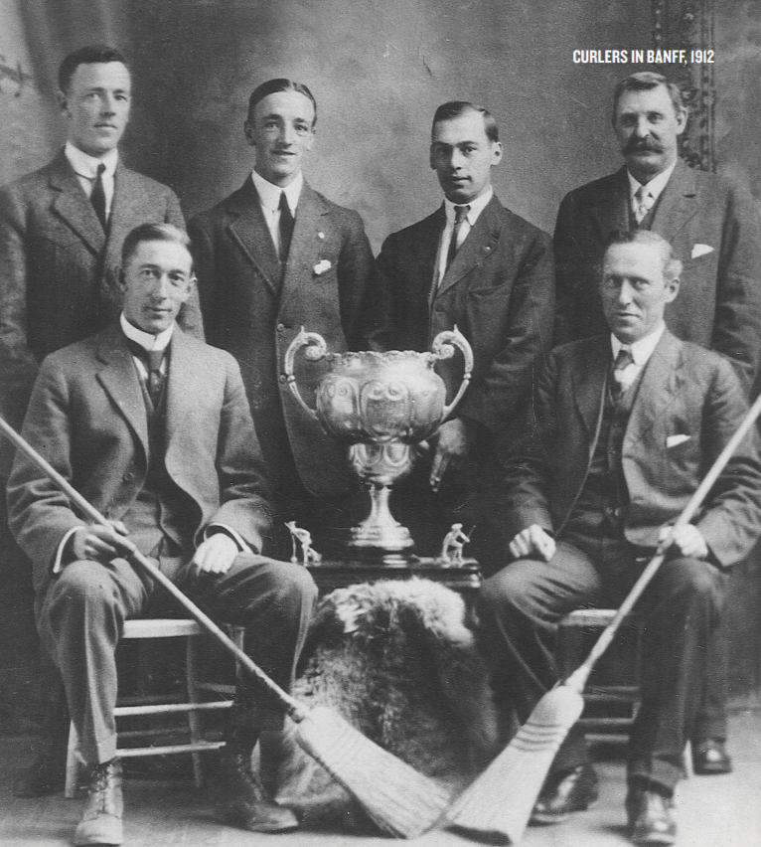
A CANADIAN PASTIME
Since arriving on our shores in 1759, curling
has connected Canadians and united diverse
communities on the rink. Although the sport has
changed over the centuries, the qualities which
capture our imagination persist; the tradition
of fraternity, the spirit of sportsmanship, and
the drive for excellence.
Today, Canada is the world leader in the sport.
From thriving grassroots play to the international
athletic stage, 90% of all curlers hail from Canada.
Curling is a definitive national pastime, with
traditions and values that mirror our distinctly
Canadian outlook. We are fierce but friendly
competitors. We are proud but humble.

Slide 4
NO OTHER SPORT IN CANADIAN HISTORY HAS WON A MEDAL AT EVERY OLYMPIC GAMES.

Slide 5
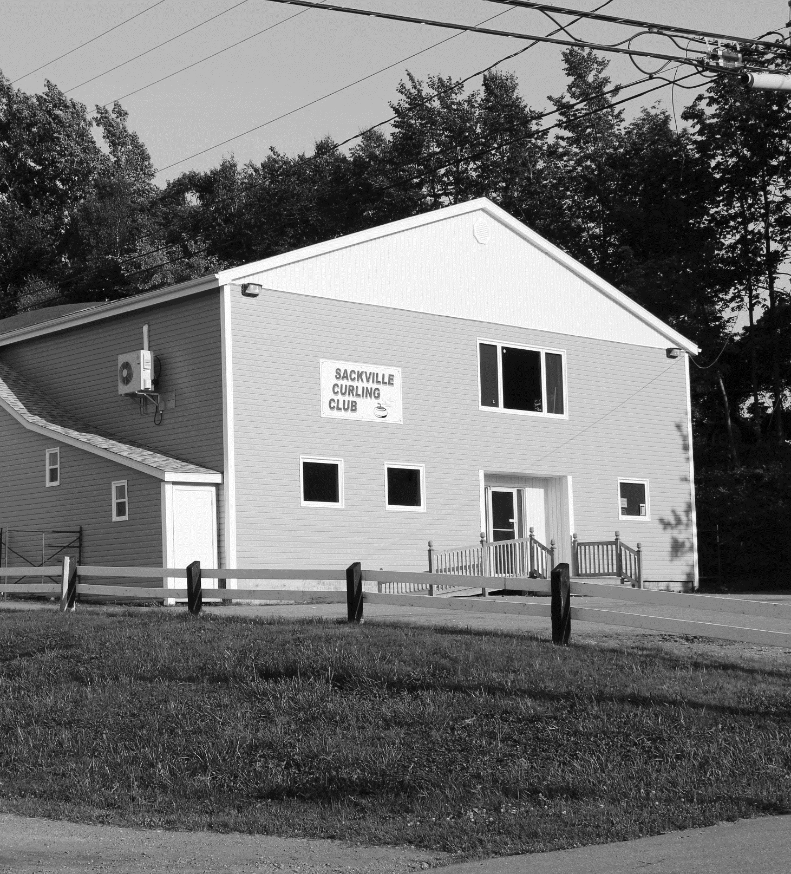
CURLING CLUBS ARE COMMUNITY HUBS
Curling Clubs are:
Inclusive
Volunteer Driven
Accessible
Gathering Places
Curling rinks are vital to some small communities, providing a venue for people of all ages to gather and engage in sport. The curling community is a diverse group of people of widely varying ages, backgrounds and socioeconomic circumstances.

Slide 6
THE ECONOMIC IMPACT
800 000
Attendance at Curling Canada Events
3400
Jobs Supported by Curling
$584 MILLION
$186 MILLION
In Economic Activity Across Canada
Of Wages and Salaries Supported by Curling

Slide 7
INSERT PROVINCE HERE
Curling In the Province

Slide 8
BY THE NUMBERS
XXX
Number of Curling Clubs
1063
Curling Sheets In the Province
XXX XXX
$10,376,949
Number of Registered Participants
Of Wages and Salaries Supported by Clubs
Notes:
Ontario

Slide 9
SPORTS TOURISM
INSERT A GRAYSCALE PICTURE OF YOUR EVENT HERE
Major Sporting Events in the Province

Slide 10
YOUTH PROGRAMS
INSERT A GRAYSCALE PICTURE OF YOUR PROGRAM HERE
Engaging the Next Generation of Curlers

Slide 11
INSERT CLUB NAME HERE
About Us

Slide 12
OUR PLACE IN THE COMMUNITY
INSERT A GRAYSCALE PICTURE OF YOUR FACILITY HERE
Insert facts here about your facility and its membership.
If you are able to highlight diversity of membership (age, gender, ethnicity, income group) this is encouraged.
Do you give back to the community? Give examples here.
Do you have a heartwarming anecdote? Include it but keep the emphasis on the facts.

Slide 13
INFRASTRUCTURE INVESTMENT OPPORTUNITIES
We Need
It Will Help
State your investment project or need here. Be concise and clear.
Share how the project/funding will benefit your community.
Notes:
NOTE: This slide can be duplicated in the case that there are multiple investment requests.

Slide 14
BUSINESS CASE
Our Need
State your institutions issue or opportunity here and explain how it is impacting the business.
The Solution
State your proposed solution. Provide details and explain any alternatives considered.
Our Costs
State your projected costs, cost assumptions and benchmarks. List any other sources of funding.
The Beneficiaries
Who will benefit from this investment? Be specific about the community/individuals it will impact.
Intended Impact
What are the direct and indirect benefits of the project overall? Are there quantifiable benefits?
Notes:
NOTE: This slide can be duplicated in the case that there are multiple investment requests.

