Slide 1

Statistics Training
Canadian Curling Association
V2013.1
Notes:
1

Slide 2
Make the game more interesting and fun for fans and players
Information for the media (primarily television) though summary reports are e-mailed to News organizations as well
Information for players and coaches
  Not a coaching tool but useful information to analyze the opposition and the ice.
Stats Objectives
Notes:
2

Slide 3
Straight forward – Easy to learn
Give the benefit of doubt to the curler
Shot evaluated according to shot called
  e.g. Bad call, impossible shot or improper broom placement does not factor into the evaluation of the shot
Stats Principles
Notes:
3

Slide 4
Scoring System
How to score shots
Notes:
4

Slide 5
Record the turn, type of shot, and score
Four point system
  zero points for a complete miss
  4 points for a fully made shot
No bonus points
CCA Scoring System
Notes:
5
A 5 can be scored if it completely changes the game around during the middle or late ends. A 6 is normally saved for a shot that gets you advanced to the next level. That could be either into a tie-breaker, into the playoffs, and on. Making a shot such as Jennifer Jones did to defeat Jenn Hanna in the 2005 Scott Tournament of Hearts deserved a 6 as it won the National Championship for Jennifer.

Slide 6
Takeout Codes
  A Straightforward hit
  B Hit with roll requested
  C Clear front stone or guard
  D Raise takeout of rock in front
Need to remember that a HIT is not coded as “H”, TAKE OUT is not coded as “T”
CCA Scoring System
Notes:
6

Slide 7
Draw Codes
  E Draw to house
    Raise own front stone into house
    Free guard zone split
  F Front stone
  G Guard
  H Freeze
  J Tap back rock in house (own or opponents)
Need to remember that a DRAW is not coded as a “D”, a FREEZE is not coded as an “F” and a TAP is not coded as a “T”
CCA Scoring System
Notes:
7

Slide 8
Scoring is easy
  0 bad shot (did not improve the situation)
  1 improved situation slightly
  2 mediocre shot (improved situation but not desired result)
  3 almost the desired result but not quite
  4 good shot (what one would normally expect)
CCA Scoring System
Notes:
8
Next level – tie-breakers, playoffs, finals, wins the championship

Slide 9
Throw through not counted
  Unless missed (left in play)
  Code as X X 0 on score sheet
Unusual Situations
  Rock removed from play for any reason is zero points
    Burned by sweepers
    Hog line violation is coded “V” in the score column
    Time violation
  Rock which picks is scored on result achieved (not all picks are misses)
CCA Scoring System
Notes:
9
Note that a picked rock may earn points for the curler and that the V may be entered as a score

Slide 10
Be consistent
  Whether scoring tough or easy, all players deserve equal treatment
  Give benefit of doubt to player
  Nothing is gained by being tough
  These are curling’s elite – their stats should be good
Tips For Scorers
Notes:
10

Slide 11
Note lefthanders during team practice prior to the game
  Lefties have opposite rotation on in and out turns
  When using a scoresheet, place an “L” by the player as a reminder
  For direct entry, the screen will indicate a lefthander
Tips For Scorers
Notes:
11

Slide 12
Be alert to players hitting out of turn
  Each rock thrown is credited to the player who threw it, adjust player number if necessary
  Clearly indicate on the scoring sheet where the order differed from normal
Watch the skip for the called shot
  Not all skips indicate the call clearly
  Score generously on an ‘no call’ or ‘missed call’
Tips For Scorers
Notes:
12

Slide 13
Watch for optional shots
  Award full points for any properly executed option. e.g.. Tick guard or get rock in house
Do not agonize a long time over any given shot
  Your first thought is likely the best
  You may miss the call for the next shot
  Change later if desired, but don’t leave a blank value, it can’t be entered in the system
Tips For Scorers
Notes:
13

Slide 14
Ice conditions affect strategy and scoring
  On swingy ice guards must be tighter and are more difficult to position
  On straight ice hits are simpler and draws around guards more difficult
  Where ice conditions have made a shot easier or harder, one should raise or lower scoring standards
Adjust points for realistic results
  Adjust points for difficult shots e.g.. ‘pick’ style takeout where stay is not realistic. Award 4 points
Tips For Scorers
Notes:
14

Slide 15
Hit (A) vs Hit and Roll (B)
  Code B must be a called hit and roll (not accidental)
  If the roll is optional, award full points for a nose hit
  The perfect hit and roll (except for roll out of play) is a hard shot – use this code sparingly. If a roll is indicated but you are sure the skip would be happy with a nose hit, then use code A
Tips For Scorers
Notes:
15

Slide 16
Front stone (F) vs Guard (G)
  A ‘corner or centre guard’ is a front stone F
  A guard is any front stone specifically placed to protect an existing stone
  A draw to the rings which stops short of the rings is code E
Tips For Scorers
Notes:
16

Slide 17
Game score or situation can affect the score for a shot
  On skip’s last rock a draw which is not shot but cuts the opponent down can be given 2 or 3 but in the last end where the shot is needed to win or tie this shot is either 0 or 4
  On skip’s last rock, if they must be full four foot in order to score a second point, the score is either 0 or 4, in this case close doesn’t count
Tips For Scorers
Notes:
17

Slide 18
Practise as a group and compare results
  This will improve consistency (individual and committee)
  Score local super league games or other competitions
Tips For Scorers
Notes:
18

Slide 19
Video Practice
A chance to score a couple of ends from video
Notes:
19

Slide 20
Start on proper side of sheet
  In the first end, note who has the hammer and start of the correct side of the sheet
    Put an asterisk beside the team name of the team that has hammer for data entry
For each shot, indicate:
  Handle: I or O (beware of lefties)
  Type of shot A B C D or E F G H J
  Points: 0 to 4
  V for hog line violation (0 points awarded by program)
Enter score for the end
  Score for this end only (not game total)
Scoring Essentials
Notes:
20
Sheet entry – computer always has red on left
Direct entry – computer will change according to hammer

Slide 21
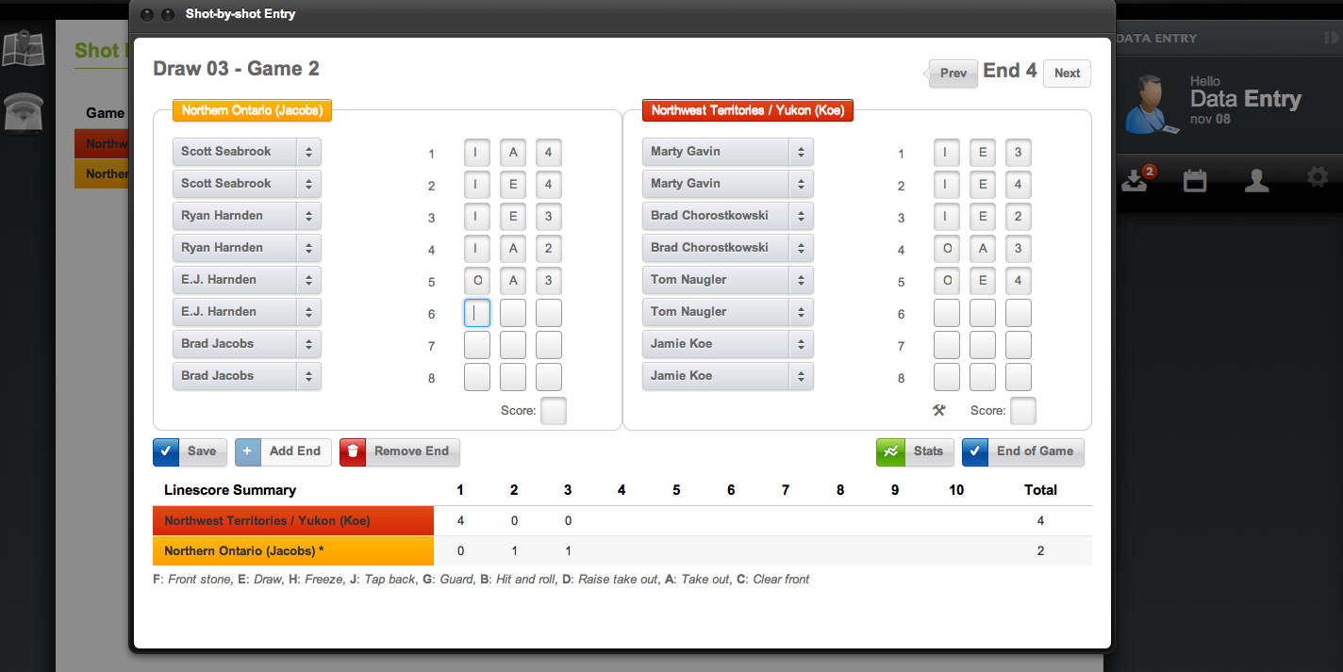
Data Entry Screen
Notes:
21
Sheet entry – computer always has red on left
Direct entry – computer will change according to hammer

Slide 22
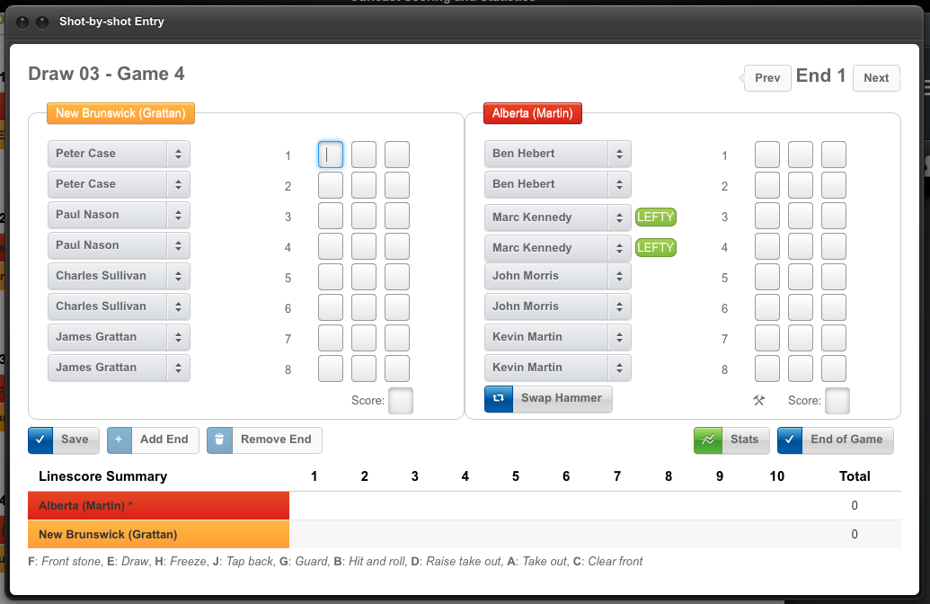
Ensure computer set on correct sheet, draw and first end
Ensure correct initial line-up and correct using drop-down
Ensure right team is on the left side of the screen using “swap hammer” button
Data Entry Screen
Notes:
22

Slide 23
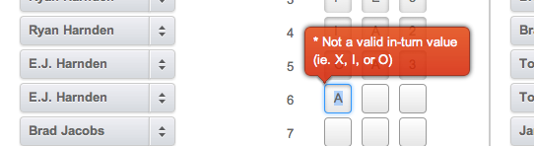
The software will make sure you only enter the correct value for the turn
  When the value is highlighted with a blue background, just type the new value, otherwise double-click in the field first
Data Entry Screen
Notes:
23

Slide 24
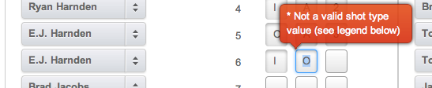
The software will make sure you only enter the correct value for the shot type
  When the value is highlighted with a blue background, just type the new value, otherwise double-click in the field first
Data Entry Screen
Notes:
24

Slide 25
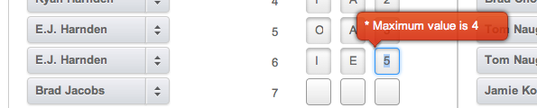
The software will make sure you only enter the correct value for the score
  When the value is highlighted with a blue background, just type the new value, otherwise double-click in the field first
Data Entry Screen
Notes:
25

Slide 26
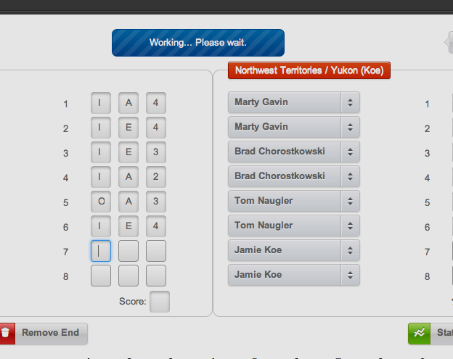
The blue box at the top indicates that the system is saving data
It appears after you enter a score and should disappear after a few seconds
  You can continue to type but don’t use the mouse when it is showing
Data Entry Screen
Notes:
26

Slide 27
Statistics at the Event
People, Scheduling, and other procedures before and during the event
Notes:
27

Slide 28
Roles
  Scorer
  Runner/Spare
  Data Entry
  Assistant (optional)
  Supervisor
  CCA Results Manager
Stats Personnel
Notes:
28
Runner/Spare – in sheet entry environment, collect sheets and return to data entry
Data Entry – enter information into computer (sheet entry) or laptop (direct entry)
Assistant – optional position depending on # of available volunteers
Supervisor – organizes volunteers schedule, prepares reports, liaise with Curl BC

Slide 29
Before game
  Arrive at least 30 minutes before
  Ask supervisor of any lineup changes
  Gather supplies and take seat
    Clipboard with 11 score sheets
    Two pens or pencils
    Team and player identification
    Scoring guidelines
    Binoculars optional
  If scoring on paper
    Complete header section of 10 score sheets
    Note lefties on each sheet by watching the team practice
Scorer Logistics
Notes:
29

Slide 30
During game
  For the first end only, write the player’s name under the player number on the sheet as they are actually throwing
    This alerts the Results Manager to a lineup change
  Be alert to lefties to code proper turn
  Be alert to players throwing out of turn and player substitutions
  Be alert to hog line violations, ‘V’ points
  Note:
    Start each end on proper side of sheet
    Runner or supervisor will collect completed sheets
Scorer Logistics
Notes:
30

Slide 31
When game is complete
  Code all throw throughs as X X 0
  Record score for final end (may be X X)
  Record final game time (after extra end if it occurs)
  Check ‘End of Game’ box
  Make sure runner or supervisor gets your final sheet
Scorer Logistics
Notes:
31

Slide 32
An essential role for events with data entry
Collects sheets from scorers in a sheet entry environment
Proof read scoresheet, checking score for end and data correct for each team
  Watch for missing number or codes and ask scorer to complete
Maintain linescore sheet
Can fill in for another scorer if,
  Someone doesn’t show up
  Someone has to leave during the game
  Someone needs a break during the game
Runner/Spare
Notes:
32

Slide 33
For events that use sheet entry on some or all sheets, enters the scores into the program
One or two people
  With two people, one person typically reads the sheet and the other person types, then the reverse to verify the data entered
Essential to have data entry people for sheet entry events (Results Manager is not the data entry person)
Data Entry
Notes:
33

Slide 34
If there is no runner/spare
  Collects sheets from scorers in a sheet entry environment
  Proof read scoresheet, checking score for end and data correct for each team
    Watch for missing number or codes and ask scorer to complete
Spare for scorers or data entry personnel
Assists Statistics Supervisor during each draw as required
May be the supervisor at the second site for 2 site events (eg. Juniors, Seniors)
Supervisor Assistant
Notes:
34
This position may or may not be required depending on the size of the event and method of entry

Slide 35
Creates the master schedule
  Try to keep the number of scorers small
  Schedule scorers on the same sheet each time
    Remember that the teams rotate across sheets so the scorers shouldn’t otherwise they may score the same team too many times
Makes sure that people are aware of when they are scheduled
Statistics Supervisor
Notes:
35

Slide 36
  Results Manager is responsible for the quality of the stats, ensures updates get to the internet, troubleshoots technical problems, etc.
  In the early draws, the Results Manager needs to be coaching the scorers where necessary
Results Manager
Notes:
36

Slide 37
Questions?
Notes:
37

